Slide 1
ECE 5706: Resilient Computer System Design
Course Introduction
Xin Xin
Assistant Professor
Electrical and Computer Engineering
ACKNOWLEDGEMENT:
Prof. Behrooz Parhami at UCSB
Prof. Ronald F. DeMara at UCF
Notes:
<number>

Slide 2
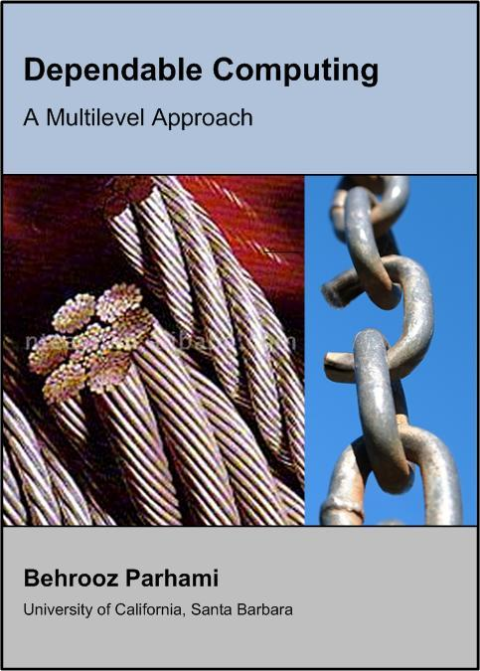
How the Cover Image Relates to Our Course
Dependability as weakest-link attribute: Under stress, the weakest link will break, even if all other links are superstrong
- Improve the least reliable part first
Safety factor (use of redundancy):
Provide more resources than needed for the minimum acceptable functionality
Additional resources not helpful if:
- failures are not independent
- Some critical component fails
Slide <number>
Notes:
<number>
Improve the least reliable part first also implies the importance of correction
Failures are not independent: If failures are correlated—meaning one failure directly influences or triggers another—the redundancy may not be effective. In systems where components are interdependent, the failure of one component can lead to a cascade of failures across the redundant units, negating the safety provided by having multiple units.
Some critical component fails: If the system's design has a single point of failure or a component that, upon failure, causes the entire system to fail, then redundancy in other parts of the system does not contribute to overall safety. For example, if a critical sensor or controller in a system fails and there is no backup for this component, the system can still fail despite redundancies elsewhere.

Slide 3
About the Name of This Course
Fault-tolerant computing: a discipline that began in the late 1960s – 1st Fault-Tolerant Computing Symposium (FTCS) was held in 1971
In the early 1980s, the name “dependable computing” was proposed for the field to account for the fact that tolerating faults is but one approach to ensuring reliable computation. The terms “fault tolerance” and “fault-tolerant” were so firmly established, however, that people started to use “dependable and fault-tolerant computing.”
In 2000, the premier conference of the field was merged with another and renamed “Int’l Conf. on Dependable Systems and Networks” (DSN)
In 2004, IEEE began the publication of IEEE Trans. On Dependable and Secure Systems (inclusion of the term “secure” is for emphasis, because security was already accepted as an aspect of dependability)
Slide <number>

Slide 4
Why This Course Shouldn’t Be Needed
In an ideal world, methods for dealing with faults, errors, and other impairments in hardware and software would be covered within every computer engineering course that has a design component
Analogy: We do not teach structural engineers about building bridges in one course and about bridge safety and structural integrity during high winds or earthquakes in another (optional) course
Logic Design:
fault testing,
self-checking
Parallel Comp.:
reliable commun.,
reconfiguration
Programming:
bounds checking,
checkpointing
Fault-Tolerant Computing
Slide <number>
Notes:
From my research PIM, is important
But is also not important, because correlated
<number>

Slide 5

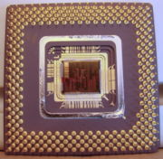
Brief History of Dependable Computing
1940s: ENIAC, with 17.5K vacuum tubes and 1000s of other electrical
elements, failed once every 2 days (avg. down time = minutes)
1950s: Early ideas by von Neumann (multichannel, with voting)
and Moore-Shannon (“crummy” relays)
1960s: NASA and military agencies supported research for
long-life space missions and battlefield computing
1970s: The field developed quickly (international conference,
many research projects and groups, experimental systems)
1980s: The field matured (textbooks, theoretical developments,
use of ECCs in solid-state memories, RAID concept),
but also suffered some loss of focus and interest
because of the extreme reliability of integrated circuits
1990s: Increased complexity at chip and system levels made
verification, testing, and testability prime study topics
2000s: Resurgence of interest owing to less reliable fabrication at
ultrahigh densities and “crummy” nanoelectronic components
2010s: Integration of reliability, safety, privacy, and security concerns,
particularly in the cloud, artificial intelligence systems, and IoT
Slide <number>
Notes:
<number>
ENIAC had special provisions for fault tolerance and quick repair; otherwise, it could not have done anything useful at all. The early version was up only half the time, but later improvements raised its MTBF to ~2 days.

Slide 6
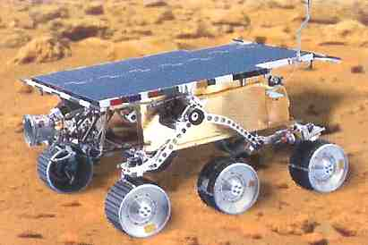

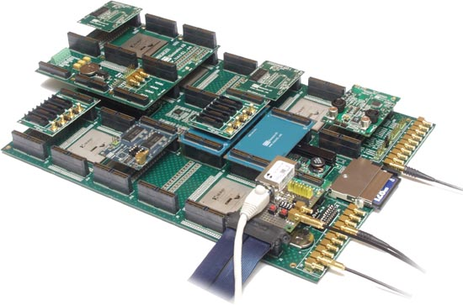
Dependable Computing in the 2020s
There are still ambitious projects; space and elsewhere
Harsh environments (vibration, pressure, temperatures)
External influences (radiation, micrometeoroids)
Need for autonomy (commun. delays, unmanned probes)
Life & death situations (transportation, self-driving cars)
The need is expanding
More complex systems (supercomputers in our pockets)
Critical applications (medicine, transportation, finance)
Expanding pool of unsophisticated users
Continued rise in maintenance costs
Digital-only data (needs more rigorous backup)
The emphasis is shifting
COTS-based hardware, with software assist
Integrated HW/SW/firmware systems-on-chip
Swarms of units with disposable subsystems
Fairness, equity, and social-justice concerns
Slide <number>
Notes:
<number>

Slide 7
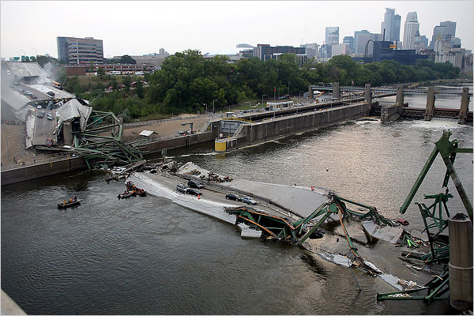
August 1, 2007 – Interstate 35W
Bridge 9340 over the Mississippi, in Minneapolis
(40-year old bridge was judged structurally deficient in 1990)
Slide <number>
Notes:
<number>

Slide 8
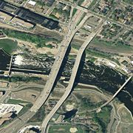
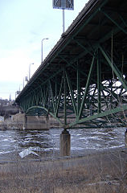

History of Bridge 9340 in Minneapolis
1967: Opens to traffic
1990: Dept. of Transportation
classifies bridge as
“structurally deficient”
1993: Inspection frequency
doubled to yearly
1999: Deck and railings fitted
with de-icing system
2001: U. Minn. engineers
deem bridge struc. deficient
Summer 2007: $2.4M of
repairs/maintenance
on deck, lights, joints
Sep. 18, 2008:
Replacement bridge opens
2004-07: Fatigue potential
and remedies studied
Aug. 1, 2007: Collapses
at 6:05 PM, killing 7
2007: Inspection plan chosen
over reinforcements
Slide <number>
Notes:
<number>

Slide 9
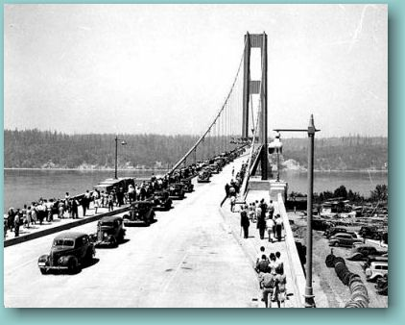
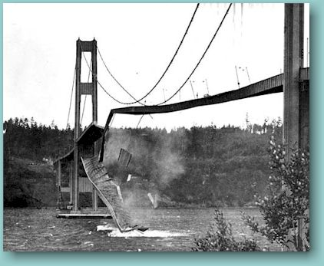

What Do We Learn from Bridges that Collapse?
Opening day of the
Tacoma Narrows Bridge,
July 1, 1940
Nov. 7, 1940
One catastrophic bridge collapse every 30 years or so
See the following amazing video clip (Tacoma Narrows Bridge):
http://www.enm.bris.ac.uk/research/nonlinear/tacoma/tacnarr.mpg
“ . . . failures appear to be inevitable in the wake of prolonged success, which encourages lower margins of safety. Failures in turn lead to greater safety margins and, hence, new periods of success.”
Henry Petroski, To Engineer is Human
Slide <number>
Notes:
<number>
Petroski goes on to conclude that we learn more from failures than from successes

Slide 10
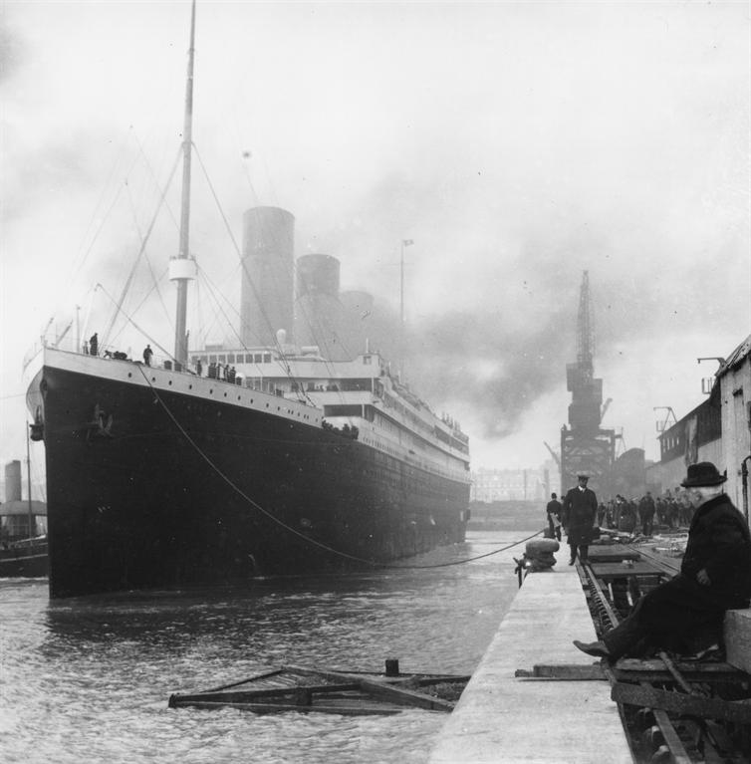
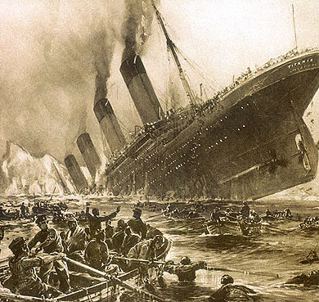
. . . or from “Unsinkable” Ships that Sink?
Titanic begins
its maiden voyage
from Queenstown,
April 11, 1912
(1:30 PM)
April 15, 1912
(2:20 AM)
“The major difference between a thing that might go wrong and a thing that cannot possibly go wrong is that when a thing that cannot possibly go wrong goes wrong, it usually turns out to be impossible to get at or repair.”
Douglas Adams, author of The Hitchhiker’s Guide to the Galaxy
Slide <number>
Notes:
<number>

Slide 11
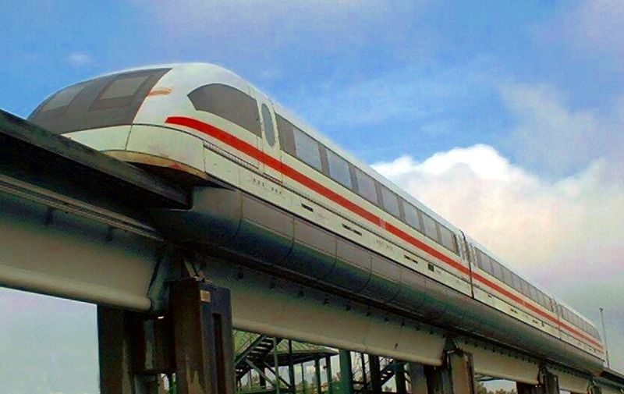
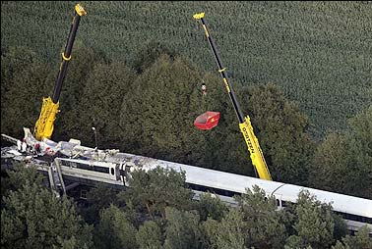
. . . or from Poorly Designed High-Tech Trains?
Transrapid
maglev train on
its test track
Sep. 22, 2006
Train built for demonstrating magnetic levitation technology in northwest Germany rams into maintenance vehicle left on track at 200 km/h, killing 23 of 29 aboard
Official investigation blames the accident on human error (train was allowed to depart before a clearance phone call from maintenance crew)
Not a good explanation; even low-tech trains have obstacle detection systems
Even if manual protocol is fully adequate under normal conditions, any engineering design must take unusual circumstances into account (abuse, sabotage, terrorism)
Slide <number>
Notes:
<number>

Slide 12
Design Flaws in Computer Systems
Hardware example: Intel Pentium processor, 1994
For certain operands, the FDIV instruction yielded a wrong quotient
Amply documented and reasons well-known (overzealous optimization)
Software example: Patriot missile guidance, 1991
Missed intercepting a scud missile in 1st Gulf War, causing 28 deaths
Clock reading multiplied by 24-bit representation of 1/10 s (unit of time)
caused an error of about 0.0001%; normally, this would cancel out in relative time calculations, but owing to ad hoc updates to some (not all) calls to a routine, calculated time was off by 0.34 s (over ≈100 hours), during which time a scud missile travels more than 0.5 km
User interface example: Therac 25 machine, mid 1980s¹
Serious burns and some deaths due to overdose in radiation therapy
Operator entered “x” (for x-ray), realized error, corrected by entering “e” (for low-power electron beam) before activating the machine; activation was so quick that software had not yet processed the override
¹ Accounts of the reasons vary
Slide <number>
Notes:
<number>
Microsoft Excel flaw, discovered in late September 2007, was assigned as homework in fall 2007.

Slide 13
Causes of Human Errors in Computer Systems
1. Personal factors (35%): Lack of skill, lack of interest or motivation, fatigue, poor memory, age or disability
2. System design (20%): Insufficient time for reaction, tedium, lack of incentive for accuracy, inconsistent requirements or formats
3. Written instructions (10%): Hard to understand, incomplete or inaccurate, not up to date, poorly organized
4. Training (10%): Insufficient, not customized to needs, not up to date
5. Human-computer interface (10%): Poor display quality, fonts used, need to remember long codes, ergonomic factors
6. Accuracy requirements (10%): Too much expected of operator
7. Environment (5%): Lighting, temperature, humidity, noise
Because “the interface is the system” (according to a popular saying), items 2, 5, and 6 (40%) could be categorized under user interface
Slide <number>
Notes:
<number>
Reference for the 7 factors and their share of errors – Robert W. Bailey, Human Error in Computer Systems, Prentice Hall, 1983.
A more general reference – James Reason, Human Error, Cambridge U. Press, 1990.

Slide 14
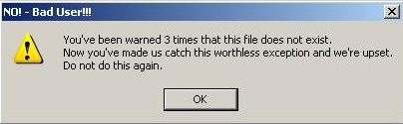
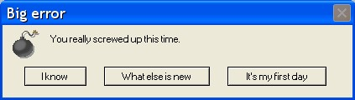
Slide <number>
Notes:
<number>
Computer error messages are often cryptic, condescending, or unhelpful. Most violate key attributes of a good user interface.

Slide 15
Properties of a Good User Interface
1. Simplicity: Easy to use, clean and unencumbered look
2. Design for error: Makes errors easy to prevent, detect, and reverse; asks for confirmation of critical actions
3. Visibility of system state: Lets user know what is happening inside the system from looking at the interface
4. Use of familiar language: Uses terms that are known to the user (there may be different classes of users, each with its own vocabulary)
5. Minimal reliance on human memory: Shows critical info on screen; uses selection from a set of options whenever possible
6. Frequent feedback: Messages indicate consequences of actions
7. Good error messages: Descriptive, rather than cryptic
8. Consistency: Similar/different actions produce similar/different results and are encoded with similar/different colors and shapes
Slide <number>
Notes:
<number>
Rules for human interface design (from http://www.visualexpert.com/Resources/compneg.html )

Slide 16
How We Benefit from Failures
1912
1940
2006
“When a complex system succeeds, that success masks its proximity to failure. . . . Thus, the failure of the Titanic contributed much more to the design of safe ocean liners than would have her success. That is the paradox of engineering and design.”
Henry Petroski, Success through Failure: The Paradox
of Design, Princeton U. Press, 2006, p. 95
Slide <number>
Notes:
<number>

Slide 17
Take-Home Survey Form: Due Next Class
Personal and contact info: Name, e-mail address, institutions, advisor
Main reason for taking this course
e.g.: interest, advisor’s suggestion, have to (not enough grad courses)
Your expectation regarding this course
e.g.: Specific Techniques, Research Hints
Slide <number>
Notes:
<number>

Slide 18
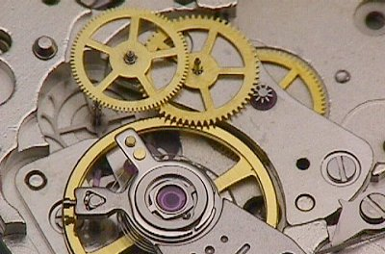
1 Background and Motivation
Slide <number>
Notes:
<number>

Slide 19
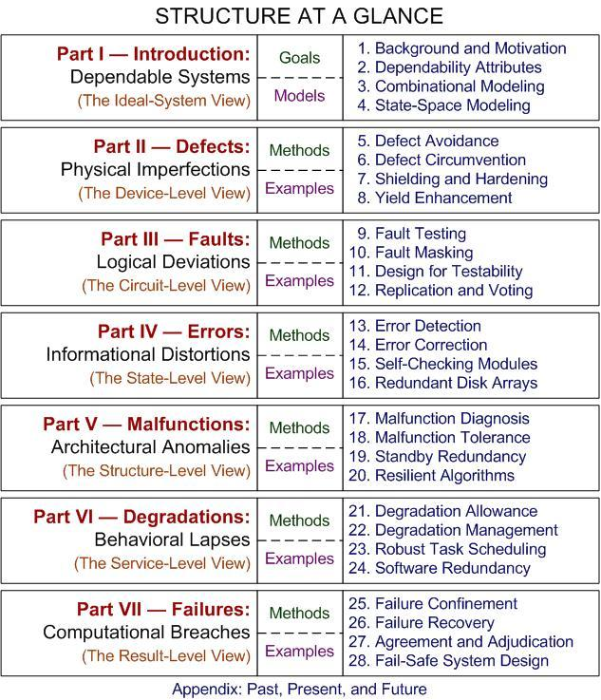
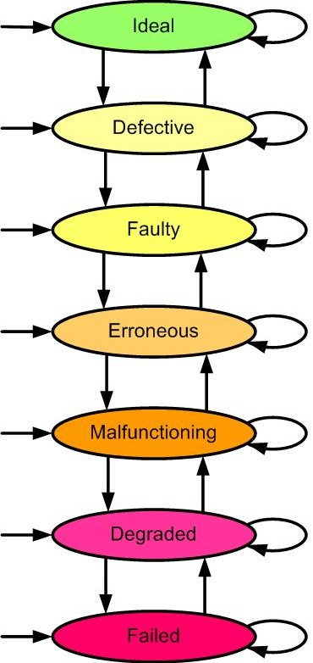
Slide <number>
Notes:
<number>

Slide 20
1.1 The Need for Dependability
Hardware problems
Permanent incapacitation due to shock, overheating, voltage spike
Intermittent failure due to overload, timing irregularities, crosstalk
Transient signal deviation due to alpha particles, external interference
Software problems
These can also be classified as design flaws
Counter or buffer overflow
Out-of-range, unreasonable, or unanticipated input
Unsatisfied loop termination condition
Dec. 2004: “Comair runs a 15-year old scheduling software package from SBS International (www.sbsint.com). The software has a hard limit of 32,000 schedule changes per month. With all of the bad weather last week, Comair apparently hit this limit and then was unable to assign pilots to planes.”
It appears that they were using a 16-bit integer format to hold the count.
June 1996: Explosion of the Ariane 5 rocket 37 s into its maiden flight was due to a silly software error. For an excellent exposition of the cause, see:
http://www.comp.lancs.ac.uk/computing/users/dixa/teaching/CSC221/ariane.pdf
Slide <number>

Slide 21
The Curse of Complexity
Computer engineering is the art and science of translating user requirements we do not fully understand; into hardware and software we cannot precisely analyze; to operate in environments we cannot accurately predict; all in such a way that the society at large is given
no reason to suspect the extent of our ignorance.¹
Microsoft Windows NT (1992): ≈4M lines of code
Microsoft Windows XP (2002): ≈40M lines of code
Intel Pentium processor (1993): ≈4M transistors
Intel Pentium 4 processor (2001): ≈40M transistors
Intel Itanium 2 processor (2002): ≈500M transistors
¹Adapted from definition of structural engineering: Ralph Kaplan, By Design: Why There Are No Locks on the Bathroom Doors in the Hotel Louis XIV and Other Object Lessons, Fairchild Books, 2004, p. 229
Slide <number>
Notes:
<number>
Structural engineering is the art and science of molding materials we do not fully understand; into shapes we cannot precisely analyze; to resist forces we cannot accurately predict; all in such a way that the society at large is given no reason to suspect the extent of our ignorance.
The dual-core version of Itanium 2 is already past the 1B-transistor milestone.

Slide 22
Defining Failure
Failure is an unacceptable difference between expected and observed performance.¹
A structure (building or bridge) need not collapse catastrophically to be deemed a failure
Implementation
Specification
≈
?
Reasons of typical Web site failures
Hardware problems: 15%
Software problems: 34%
Operator error: 51%
¹ Definition used by the Tech. Council on Forensic Engineering of the Amer. Society of Civil Engineers
Slide <number>
Notes:
<number>
Citation for the definition of failure – Carper, K.L., “Construction Pathology in the United States,” Structural Engineering International, Vol. 6, No. 1, p. 57-60, February 1996.
Question about the definition: Expected by whom? User expectations may be different from designer’s, if specification incorrect.

Slide 23
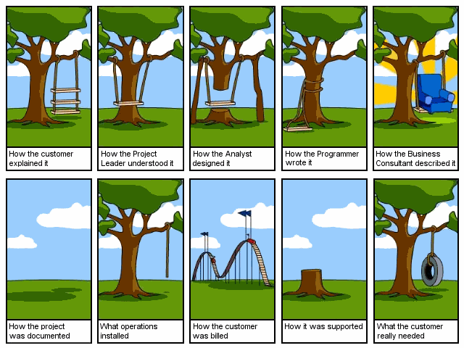
Slide <number>
Notes:
<number>
Many versions of this cartoon idea have appeared over the years. They all show that there is a disconnect between user requirements and the way these requirements are understood or implemented.

Slide 24
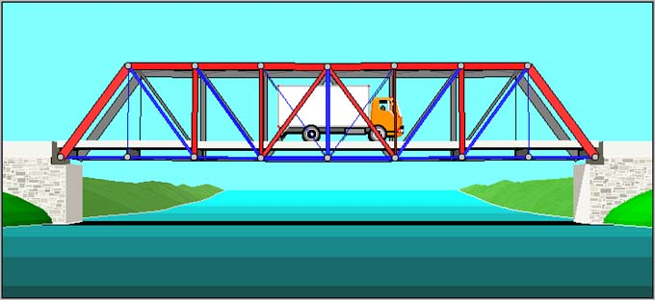

Design Flaws: “To Engineer is Human”¹
Complex systems almost certainly contain multiple design flaws
Redundancy in the form of safety factor is routinely used in buildings and bridges
Example of a more subtle flaw: Disney Concert Hall in Los Angeles reflected light into nearby building, causing discomfort for tenants due to blinding light and high temperature
¹ Title of book by Henry Petroski
Slide <number>
Notes:
<number>
Another Frank Gehry building (the Weatherhead School of Management at Case Western Reserve Univ.) shed snow and ice off its sloping stainless steel roof, presenting a hazard to pedestrians. Solution: installation of heating cables to prevent snow and ice from building up. [Petroski, Success through Failure, p. 52].

Slide 25
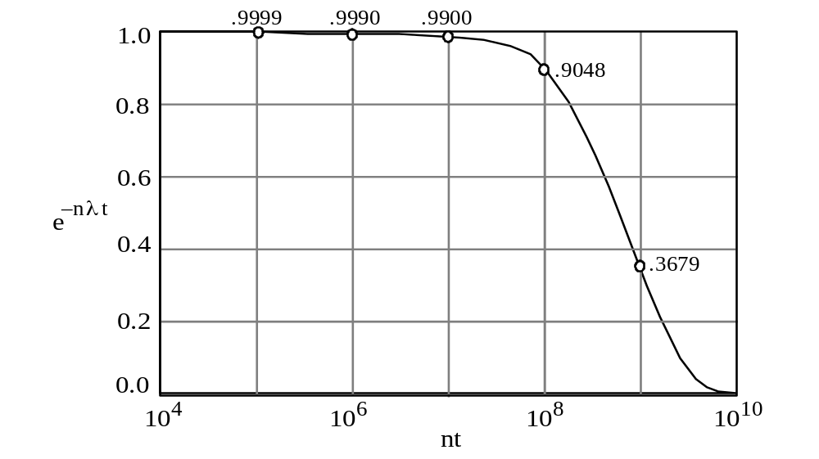
Why Dependability Is a Concern
Reliability of n-transistor system, each having failure rate λ
R(t) = e^{–nλt}
There are only 3 ways of making systems more reliable
Fig. 1.1
Reduce λ
Reduce n
Reduce t
Alternative:
Change the reliability formula by introducing redundancy in system
Slide <number>
Notes:
<number>

Slide 26
The Three Principal Arguments
The reliability argument
λ = 10^{–9} per transistor per hour
Reliability formula R(t) = e^{–nλt}
The on-board computer of a 10-year unmanned space mission can contain only O(10³) transistors if the mission
is to have a 90% success probability
Fig. 1.1
The safety argument
Airline’s risk: O(10³) planes × O(10²) flights × 10^{–2} computer failures / 10 hr
× 0.001 crash / failure × O(10²) deaths × O($10⁷) / death = $ billions / yr
The availability argument
A central phone facility’s down time should not exceed a few minutes / yr
Mean time to failure: MTTF = 1/(nλ) →
Components n = O(10⁴), if we need 20-30 min for diagnosis and repair
Slide <number>
Notes:
<number>
Associating a $ figure with each human life may appear repulsive, but if you take the value to be infinite, you cannot build any system which may lead to loss of life

Slide 27
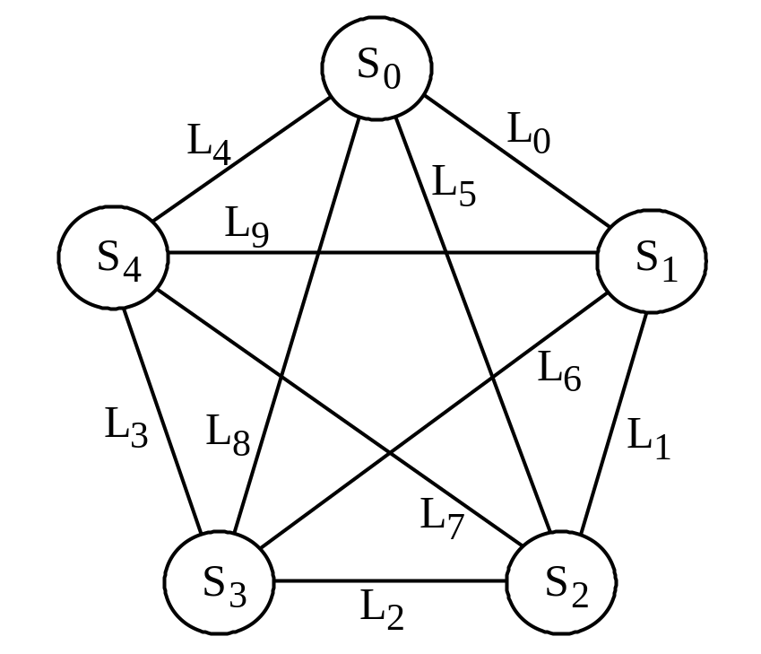
1.2 A Motivating Case Study
Data availability and integrity concerns
Distributed DB system with 5 sites
Full connectivity, dedicated links
Only direct communication allowed
Sites and links may malfunction
Redundancy improves availability
User
S: Probability of a site being available
L: Probability of a link being available
Single-copy availability = SL
Unavailability = 1 – SL
= 1 – 0.99 × 0.95 = 5.95%
F_{i}
Fig. 1.2
Data replication methods, and a challenge
File duplication: home / mirror sites
File triplication: home / backup 1 / backup 2
Are there availability improvement methods with less redundancy?
Slide <number>

Slide 28
Data Duplication: Home and Mirror Sites
S: Site availability e.g., 99%
L: Link availability e.g., 95%
F_{i} mirror
User
A = SL + (1 – SL)SL
Primary site
can be reached
Mirror site
can be reached
Primary site
inaccessible
Duplicated availability = 2SL – (SL)²
Unavailability = 1 – 2SL + (SL)²
= (1 – SL)² = 0.35%
F_{i} home
Fig. 1.2
Data unavailability reduced from 5.95% to 0.35%
Availability improved from ≈ 94% to 99.65%
Slide <number>

Slide 29
Data Triplication: Home and Two Backups
F_{i} backup 1
S: Site availability e.g., 99%
L: Link availability e.g., 95%
User
A = SL + (1 – SL)SL + (1 – SL)²SL
Primary site
can be reached
Backup 1
can be reached
Backup 2
can be reached
Primary and backup 1
inaccessible
Primary site
inaccessible
Triplicated avail. = 3SL – 3(SL)² – (SL)³
Unavailability = 1 – 3SL – 3(SL)² + (SL)³
= (1 – SL)³ = 0.02%
F_{i} home
F_{i} backup 2
Data unavailability reduced from 5.95% to 0.02%
Fig. 1.2
Availability improved from ≈ 94% to 99.98%
Slide <number>

Slide 30
Data Dispersion: Three of Five Pieces
Piece 0
A = (SL)⁴ + 4(1 – SL)(SL)³ + 6(1 – SL)²(SL)²
Piece 4
User
All 4 pieces
can be reached
Exactly 3 pieces
can be reached
Only 2 pieces
can be reached
Fig. 1.2
Piece 1
S: Site availability e.g., 99%
L: Link availability e.g., 95%
Dispersed avail. = 6(SL)² – 8(SL)³ + 3(SL)⁴
Availability = 99.92%
Unavailability = 1 – Availability = 0.08%
Piece 3
Piece 2
Scheme → Nonredund. Duplication Triplication Dispersion
Unavailability 5.95% 0.35% 0.02% 0.08%
Redundancy 0% 100% 200% 67%
Slide <number>

Slide 31
Dispersion for Data Security and Integrity
Piece 0
Encoding with
67% redundancy
l bits
a
b
c
Piece 4
Piece 1
f(x) = ax²+ bx + c
5l/3 bits
Fig. 1.2
f(0)
f(1)
f(2)
f(3)
f(4)
Piece 3
Piece 2
Note that two pieces would be inadequate for reconstruction
Slide <number>

Slide 32
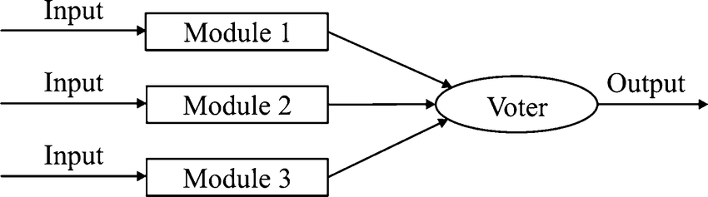
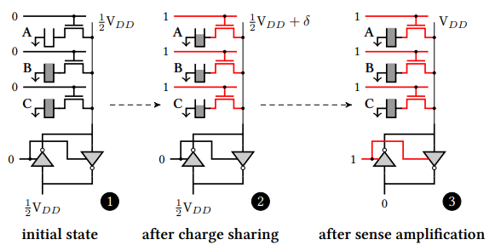
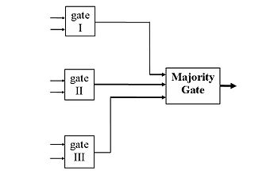
Triple modular redundancy (TMR)
Slide <number>

Slide 33
Questions Ignored in Our Simple Example
1. How redundant copies of data are kept consistent
When a user modifies the data, how to update the redundant copies (pieces) quickly and prevent the use of stale data in the meantime?
2. How malfunctioning sites and links are identified
Malfunction diagnosis must be quick to avoid data contamination
3. How recovery is accomplished when a malfunctioning site / link returns to service after repair
The returning site must be brought up to date with regard to changes
4. How data corrupted by the actions of an adversary is detected This is more difficult than detecting random malfunctions
The example does demonstrate, however, that:
● Many alternatives are available for improving dependability
● Proposed methods must be assessed through modeling
● The most cost-effective solution may be far from obvious
Slide <number>
Notes:
<number>

Slide 34
1.3 Impairments to Dependability
Hazard
Bug
Flaw
Fault
Degradation
Error
Defect
Intrusion
Malfunction
Failure
Crash
Slide <number>
Notes:
<number>

Slide 35
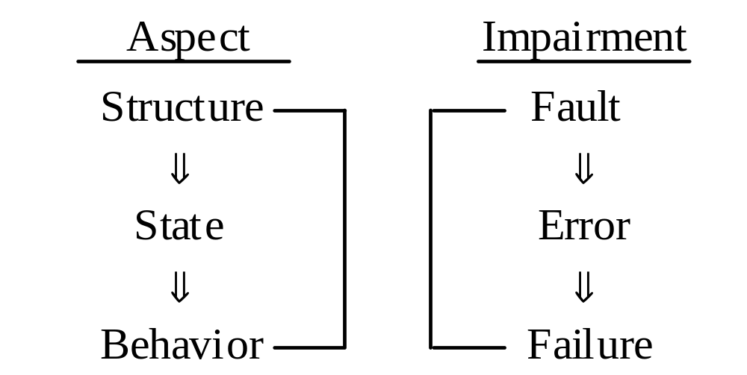
The Fault-Error-Failure Cycle
Includes both components and design
Fault
Correct
signal
0
0
0
Replaced with NAND?
Fig. 1.3
Schematic diagram of the Newcastle hierarchical model and the impairments within one level.
Slide <number>
Notes:
<number>

Slide 36
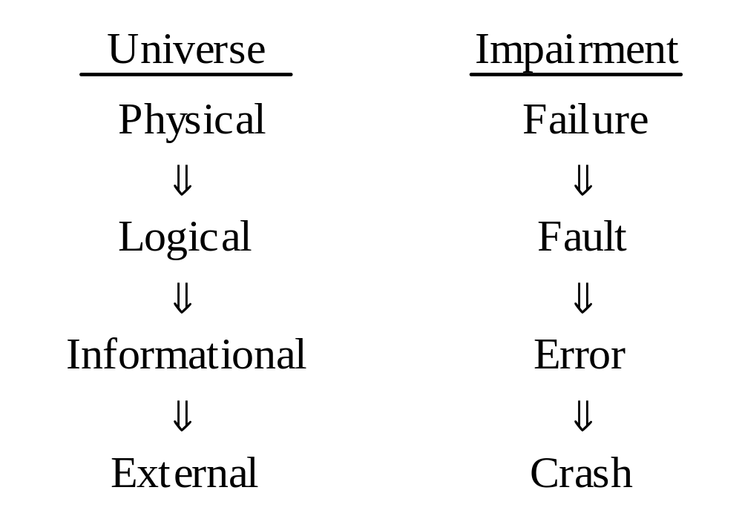
The Four-Universe Model
Fig. 1.4
Cause-effect diagram for Avižienis’ four-universe model of impairments to dependability.
Slide <number>
Notes:
<number>

Slide 37
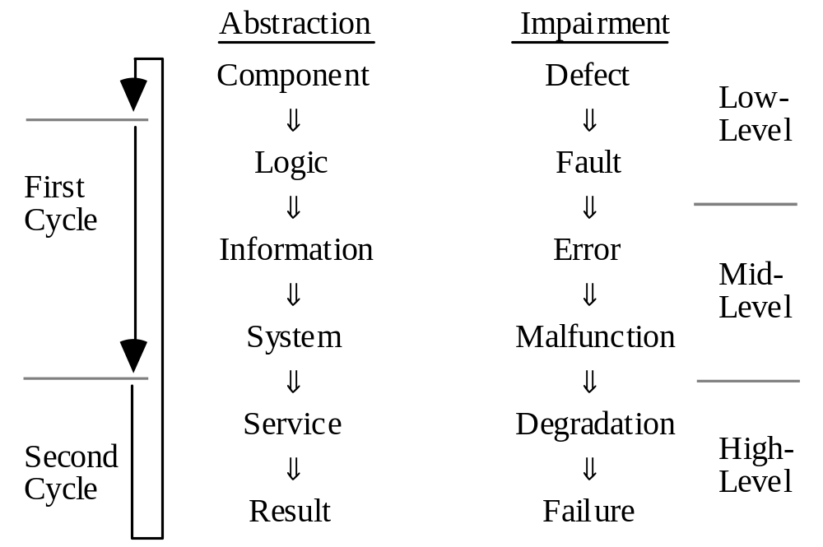
Unrolling the Fault-Error-Failure Cycle
Device
State
Fig. 1.5
Cause-effect diagram for an extended six-level view of impairments to dependability.
Slide <number>
Notes:
<number>

Slide 38
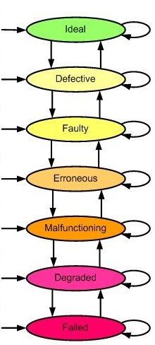
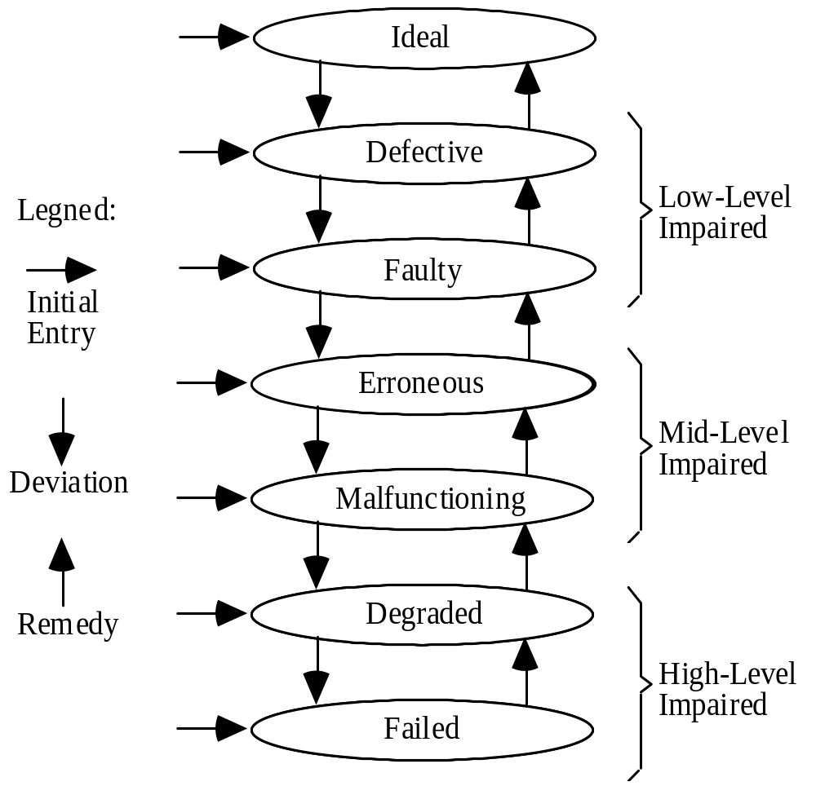
1.4 A Multilevel Model
Fig. 1.6
Device
Legend:
Logic
Entry
State
System
Service
Result
Tolerance
Slide <number>
Notes:
<number>

